Slide 1



K&O Personnel Management Systems
Created by: Jon King, Anthony Orengo

Slide 2


Team
Jon King
Anthony Orengo

Slide 3
About K&O
K&O Personnel Management System is a web-based application that uses a database to access and store user data, so organizations can better track and monitor their employees.

Slide 4
The K&O Mission
“To create a secure and reliable personnel management system for all organizations worldwide”

Slide 5
The K&O Vision
“Efficient and reliable tracking system for all organizations big & small”

Slide 6
Problem
Personnel Management
Employee Status
Time Worked

Slide 7
Solution
Create a personnel management system that tracks employee status and in/out times by use of a barcode system.

Slide 8


Technologies Used

Slide 9

Technologies Used
Hardware Technologies
Software Technologies
Coding Languages
Laptop with suitable ports
Realinn RL6200 Barcode Scanner
Apache Netbeans IDE
SQL Plus
Free MySQL Hosting
AWS(Elastic Beanstalk/Route 53)
Maria DB
Paint 3D
PowerPoint
Adobe Photoshop
Free Logo Design
Java
JSP
Javascript
HTML
CSS
SQL

Slide 10
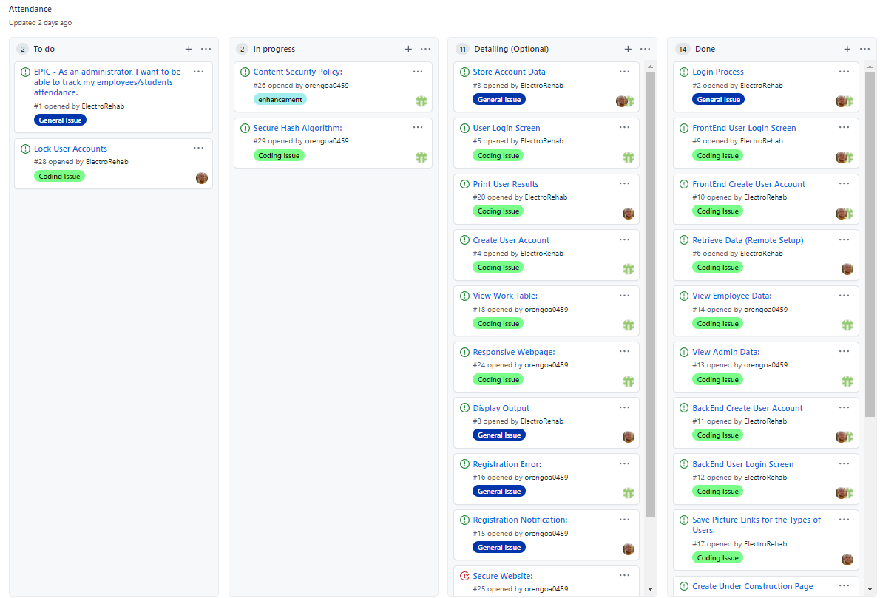
User Stories
Kanban Board

Slide 11
User Stories Cont.
# 1. EPIC - As an administrator, I want to be able to track my employees/student's attendance.

Slide 12
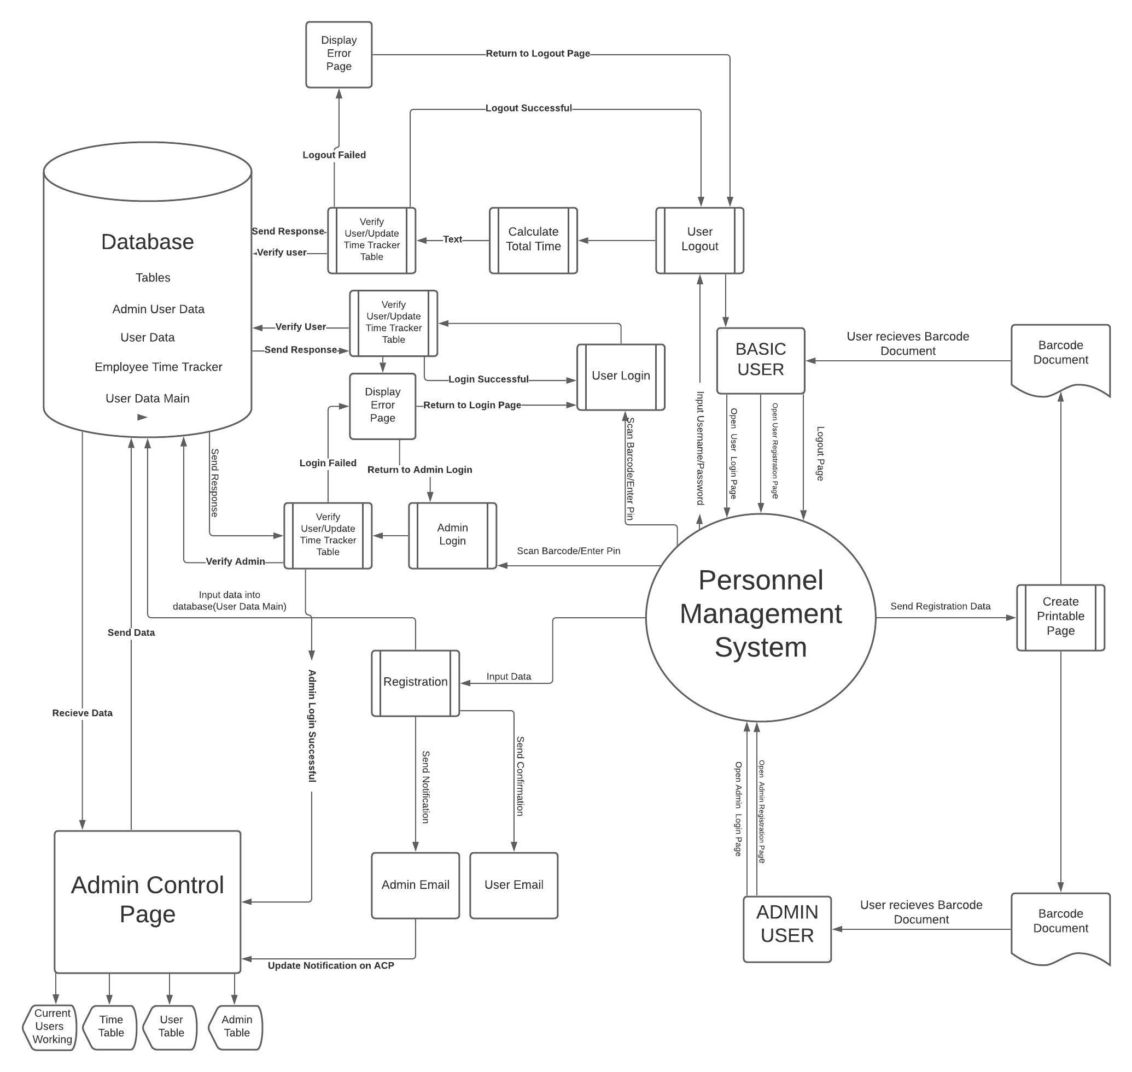
Context Diagram

Slide 13
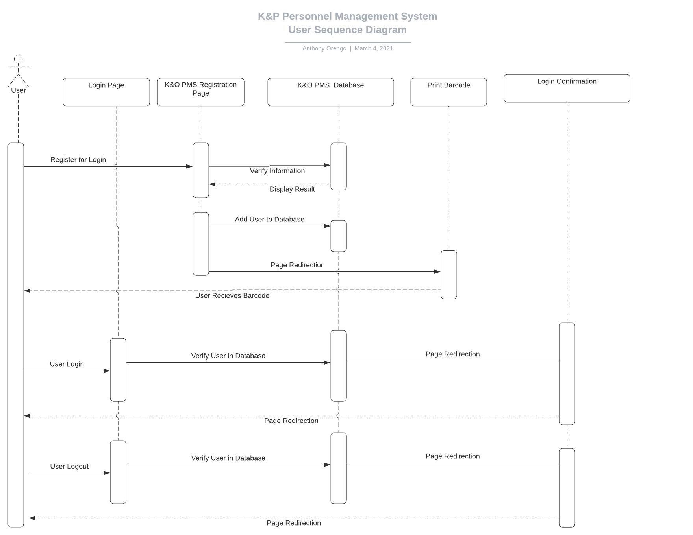
User Sequence Diagram

Slide 14
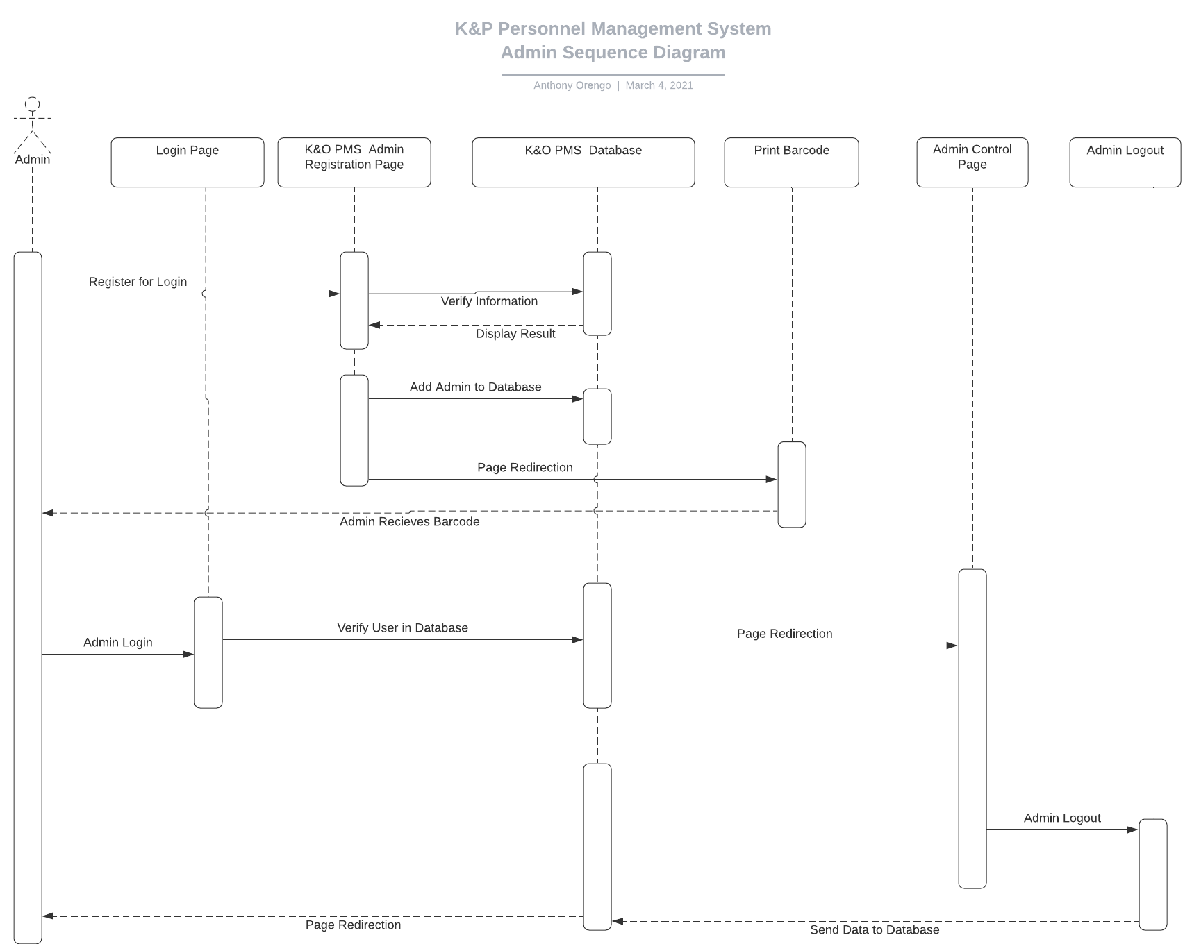
Admin Sequence Diagram

Slide 15

Application Security

Slide 16

Application Security
1. Security Methods
SQL Injection
HTTPS (SSL)
Content Security Policy(Cross-Site-Scripting)
DNSSEC Signing
SHA-2 512 bit(32byte) 128 Char Encryption
Defense In-Depth Strategies (Limit Access)

Slide 17

Live Demo

Slide 18
Questions?
Created by: Jon King, Anthony Orengo

